Slide 1


Distributed Pixels: Advancing Image Compression in Parallel Computing
Semester project

Slide 2

Our Team Members
Muhammad Yehya Hayati (K21-3309)
Syed Daniyal Haider Naqvi(K21-3433)
Muhammad Mahad Munir (K21-3388)

Slide 3

Image Compression Fundamentals
Image compression is the process of reducing the size of a digital image file while preserving its visual content. It optimizes storage space, speeds up transmission, and enhances overall system efficiency.

Slide 4
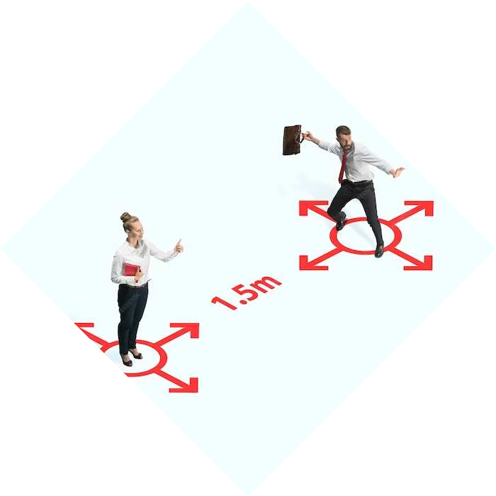
Why we need Parallel Image Processing?
Parallel processing in image compression accelerates the compression and decompression tasks by distributing the workload across multiple processors simultaneously, resulting in faster processing times. This approach optimizes efficiency, enabling swift and resource-effective image compression.

Slide 5
Implementation & Testing
Data Structures Used
Containers {Arrays, Vector}
Priority Queue {MinHeap}
Huffman Tree
Algorithm

Slide 6
23 | 69 | 90 | 87 | …
§2
23 | 2
69 | 1

Slide 7
23 | 69 | 90 | 87 | …
§2
§2
23 | 2
69 | 1
90 | 2
87 | 1

Slide 8
§16
0
1
§..
§..
0
1
§2
§2
1
0
1
0
23 | 2
69 | 1
90 | 2
87 | 1

Slide 9

Implementing Parallelization
P1
23 | 69 | 90 | 23 | …
87 | 45 | 76 | 43 | …
P2
81 | 27 | 33 | 65 | …
P3
47 | 98 | 90 | 76 | …
P4

Slide 10
CONCLUSION
In summary, our application of parallel computing in image compression not only significantly speeds up RGB value compression tasks but also demonstrates the potential for scalable and resource-efficient solutions, paving the way for enhanced performance in various image processing applications.

Slide 11
THANK YOU !

